Slide 1
All About Me Assignment
“Express” yourself.

Slide 2
6 Statements About Yourself
Come up with 6 statements that can represent you or something in your life with a number.
Write down what those 6 statements are along with the number that represents them.
Ex. Number of dogs I own… 1
Ex. Number of books I like…12

Slide 3
Write the Expressions
Use the order of operations (PEMDAS) to write an expression that, when evaluated, will equal the number representative of each of your about me statements.
You must have at least 4 operations (3 operations for Math 7) in your expressions.
You should have an exponent in at least 3 of your expressions.
You should have parentheses in at least 2 of your expressions so that, when the parentheses are removed, the result of your expression will change.

Slide 4
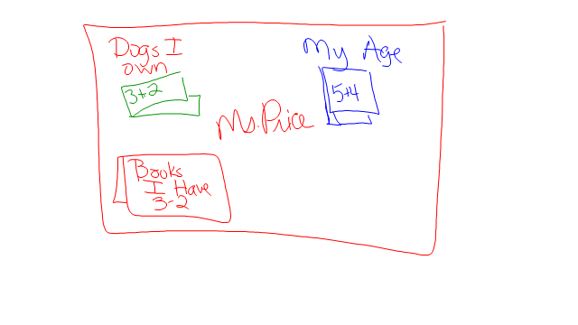
When we get back to class Thursday, we will cut and paste your statements and expressions on to your background.

